Slide 1
Predicting House Prices with Various Machine Learning Models
Project ID A5
Justin Chiong and Haydne Golden

Slide 2
The Goal
Given a dataset of house features and prices, we would like to predict future house prices using various machine learning models and compare the performance of said models

Slide 3
The Dataset
10,000 rows of house features and corresponding sale prices
Features:
Condition and quality of the house (OverallCond and OverallQual)
Size of the lot (LotFrontage and LotArea)
Number of bathrooms (FullBath and HalfBath)
Total rooms (TotRmsAbvGrd)
Construction date (YearBuilt)
Year sold (YrSold)
etc.

Slide 4
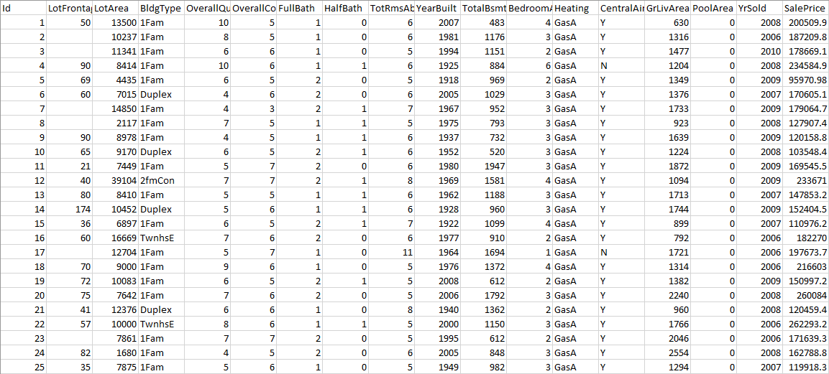
The Dataset

Slide 5
Creating the Models
We created the models using RStudio
The machine learning models:
Linear Regression
Logistic Regression (gaussian)
Logistic Regression (poisson)
Supervised Learning (XGBoost)
Necessary libraries:
library(data.table)
library(caret)
library(Metrics)
library(xgboost)

Slide 6
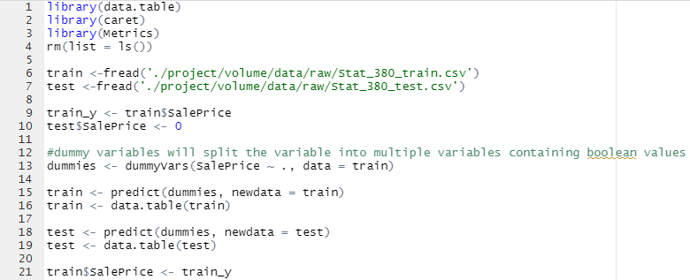
Creating the Models (regression)

Slide 7
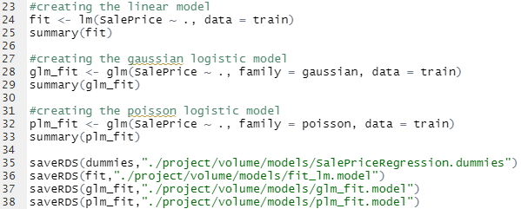
Creating the Models (regression)

Slide 8
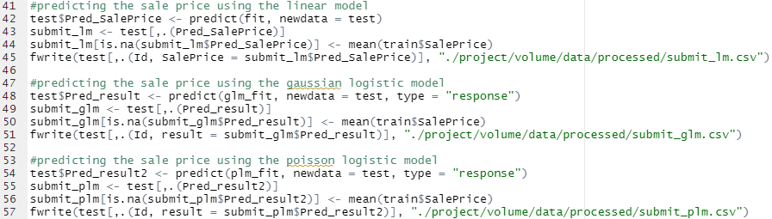
Creating the Models (regression)

Slide 9
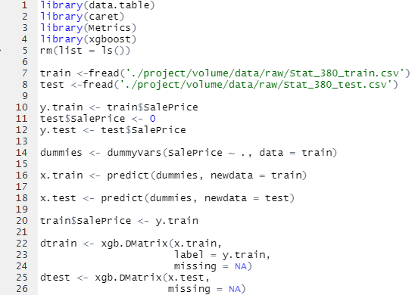
Creating the Models (supervised learning)

Slide 10
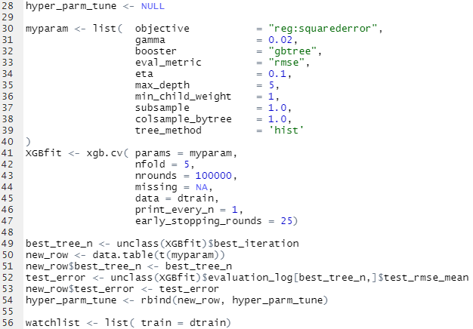
Creating the Models (supervised learning)

Slide 11
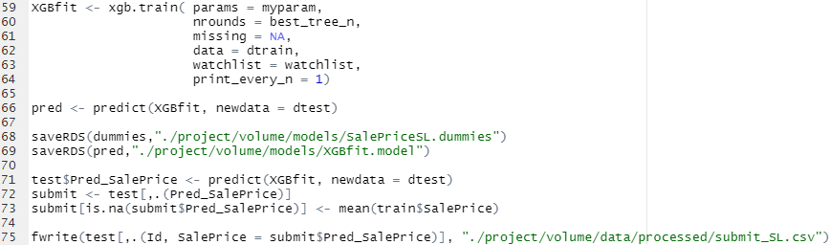
Creating the Models (supervised learning)

Slide 12
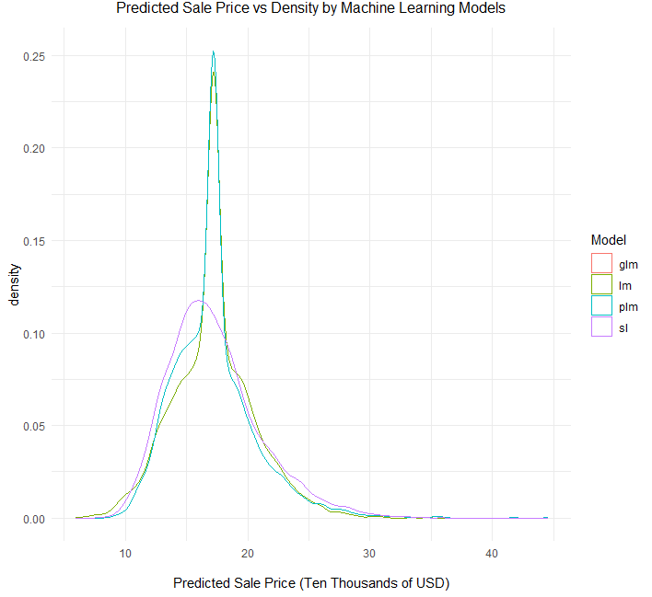
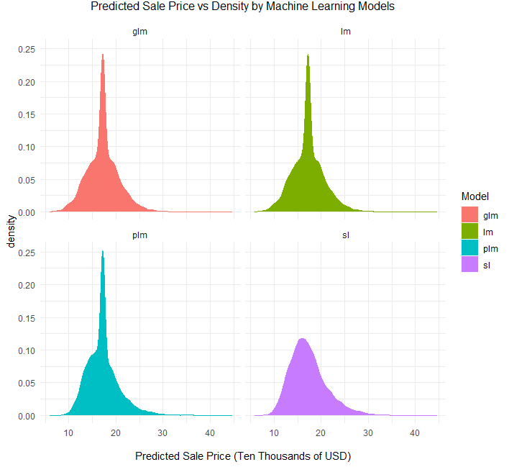
Visualizing the Data

Slide 13
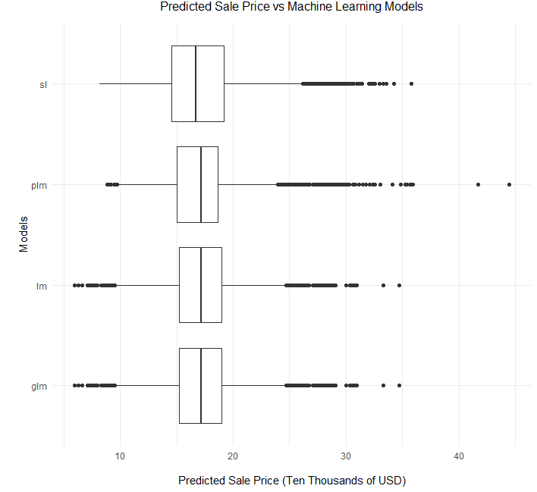
Visualizing the Data

Slide 14
Creating the Visualizations
Necessary libraries:
llibrary(ggplot2)

Slide 15
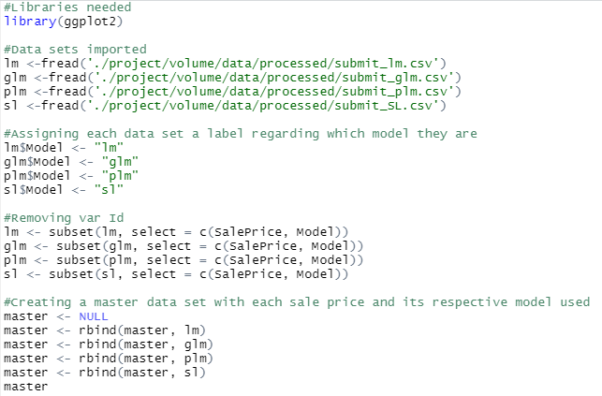
Creating the Visualizations

Slide 16
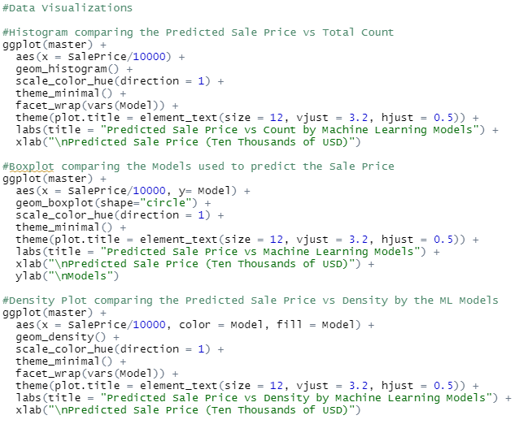
Creating the Visualizations

